Slide 1
COTM 3192: HIGHWAY ENGINEERING I
College of Technology and Built Environment
School of Built Environment
Department of Infrastructure and Technology

Slide 2
CHAPTER 1: INTRODUCTION TO ROAD PLANNING AND DESIGN
Objective: after completing this chapter the student should able to
    Understand the general considerations and approaches for route selection
    Understand the steps for determining a potential alignment
    Develop alternative alignments and identify Technically feasible alternative for further study

Slide 3
CHAPTER 1: INTRODUCTION TO ROAD PLANNING AND DESIGN
Geometric design is the process whereby the layout of the road through the terrain is designed to meet the needs of the road users.
The principal geometric features are
  Road alignment (horizontal and vertical alignment)
  the road cross-section
Geometric design starts with the selecting of route

Slide 4
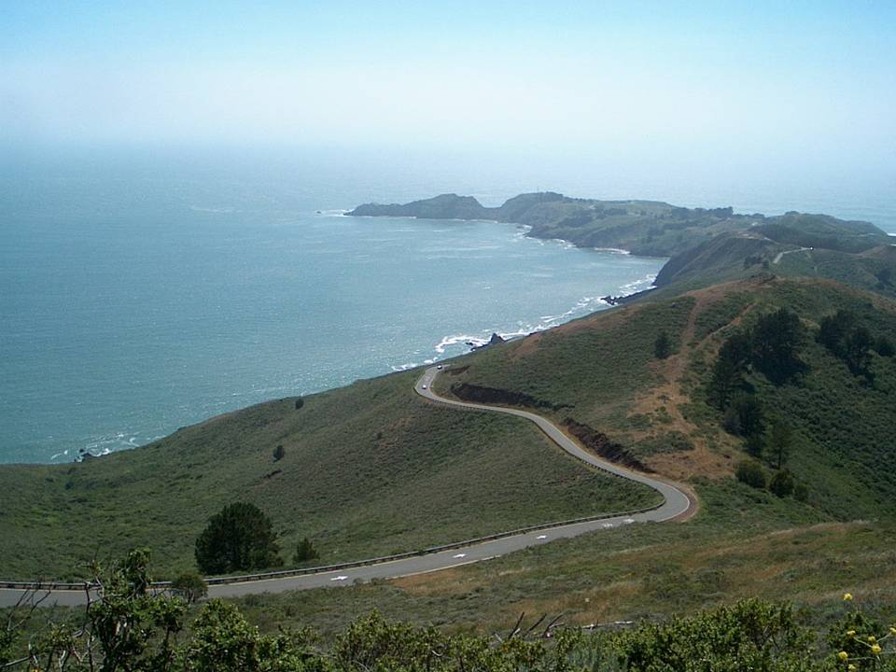
Highway Route Surveys and Investigation

Slide 5
HIGHWAY ROUTE SURVEYS AND INVESTIGATIONS
    Alignment and Route location surveys
    Guidelines for Alignment and Route location
  1. It should handle the traffic most efficiently and serve the inhabited localities.
  2. It should be in conformity with the desired lines of traffic.

Slide 6
HIGHWAY ROUTE SURVEYS AND INVESTIGATIONS
  3. A direct alignment usually results in overall economy (construction, maintenance and operation). Economy in initial cost alone is not always the optimal solution. Economy in total transportation cost should be aimed at.
  4. The gradients should not be steeper and curvature not sharper than the limiting values specified for different types of terrain or standards. Excess of either or both may result in economy of initial cost, but will involve extremely high operation costs, time costs and accident costs.
  5. The location should minimize the use of agricultural land. If a road already exists, it may be advisable to make use of the land already available to the maximum extent.

Slide 7
HIGHWAY ROUTE SURVEYS AND INVESTIGATIONS
  6. The location should involve the least impact on the environment including fauna, flora, and drainage system. Destruction of wooden area should be avoided.
  7. The location should blend with the surrounding landscape of the area and should not be a scar on it.
  8. The alignment should be located as far as possible along the edges of properties rather than through them.
  9. Obstructions such as cemeteries, places of worship, archaeological and historical monuments should be steered through.

Slide 8
HIGHWAY ROUTE SURVEYS AND INVESTIGATIONS
  10. Proximity to schools, playgrounds and hospitals should be avoided.
  11. Interference with utility services like electric transmission lines, water supply mains, sewers, other pipe-lines etc. should be avoided as far as possible.
  12. Locate the highway close to sources of embankment materials and pavement materials.
  13. Avoid marshy and low-lying land and areas having poor drainage.
  14. Avoid areas subjected to subsidence due to mining operations.
  15. Avoid areas liable to flooding.

Slide 9
Route selection:
  The origin – destination survey and estimated traffic volume studies first conducted to justify that two points needs to be connected. [this is part of Transport planning]
  Once the decision is reached to connect two points through a Road. Then the selection of the Roadway alignment is begin to ensure the most economical, technically feasible and environmentally friendly road.

Slide 10
The whole process in highway route selection can be classified in to the following four phases
  Office/ Desk Study
  Reconnaissance Survey
  Preliminary Location Survey
  Final Location Survey

Slide 11
HIGHWAY ROUTE SURVEYS AND INVESTIGATIONS
    Desk study
The first step in route survey and investigation is to study all available information in the office, Comprises a review of published and unpublished information concerning the Physical, economical and environmental characteristics of the study area .
Some of the data that may be required :
Published literatures :Road construction and maintenance case histories and geological ,economical and environmental reviews.
Topographic Map
Geological maps, Agricultural or land development map ,soil map
and other natural resource maps.
Aerial Photography

Slide 12
HIGHWAY ROUTE SURVEYS AND INVESTIGATIONS
    Available maps
REFERENCE: SOURCE
- Index Map of Coverage Scales Ethiopian Mapping Authority
- Atlas of Ethiopia Ethiopian Mapping Authority
- Topographic Maps scale 1:250,000 Ethiopian Mapping Authority
- Topographic Maps scale 1:50,000 Ethiopian Mapping Authority
- Aerial photographs, approximate scale 1:50,000 Ethiopian Mapping Authority
- Geological Map of Ethiopia, scale 1:2,000,000 Geological Survey of Ethiopia,
Ministry of Mines
- Hydrological Map of Ethiopia, scale 1:2,000,000 Ministry of Agriculture
- Land Use and Land Cover Map, scale 1:1,000,000 Ministry of Agriculture
Hydro geological Map, Scale 1:1,000, 000 Ethiopian Institute of Geological
All possible routes shall be located and examined on maps, satellite and air photos.

Slide 13
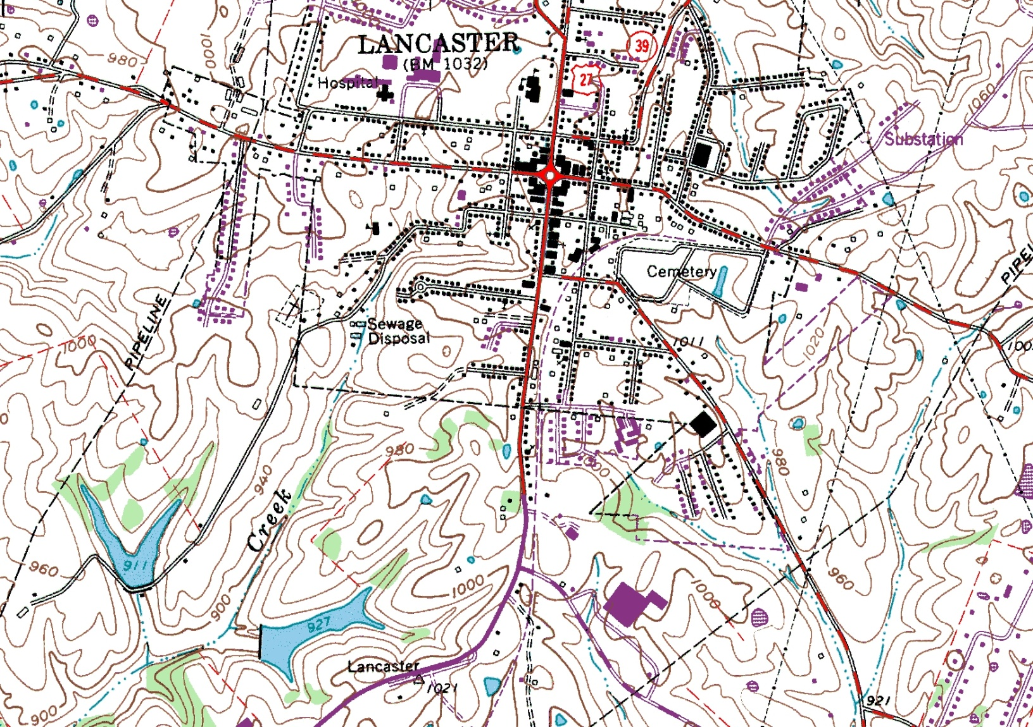
TOPOGRHAPHIC MAP

Slide 14
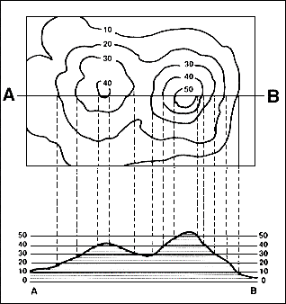
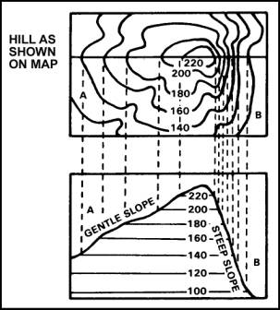
CONTOURS FROM TOPO MAP

Slide 15
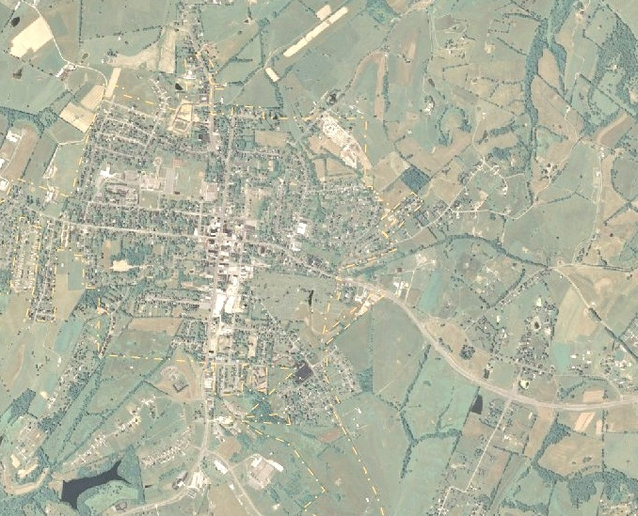
AERIAL PHOTO

Slide 16
HIGHWAY ROUTE SURVEYS AND INVESTIGATIONS
    The possible alternative routes are evaluated by the following criteria (ERA)
Relative lengths of the alternatives? Normally the shortest distance is preferable.
What are the average gradients of the alternatives? Normally the least severe grade alternative is preferred.
Which alternative more closely follows an existing road or track? This makes survey and construction easier and may indicate the route of least earthworks.
Which alternative follows the least severe terrain type? An alignment through, for instance, rolling terrain should be less costly to construct, have lower vehicle operating costs and maintenance costs, and less severe horizontal curves than a route through mountainous terrain.

Slide 17
HIGHWAY ROUTE SURVEYS AND INVESTIGATIONS
    The possible alternative routes are evaluated by the following criteria (ERA)
Which route remains for a longer period on the crest of the terrain? Such an alignment minimizes the need for drainage structures.
Which alignment minimizes the need for land acquisition? Which alignment minimizes the need to demolish buildings and houses?
What is the total number of bridges required for each alternative? What is the total aggregate length of these bridges?
Which route results in the least environmental disturbance to the surrounding area?
Which route has the least overall project cost, including both design and construction?

Slide 19
HIGHWAY ROUTE SURVEYS AND INVESTIGATIONS
    Reconnaissance survey
When the desk study is over or when the potential route corridor have been identified , the reconnaissance survey should employed
to verify interpretations, to help determine the preferred corridor,
and to identify factors that will influence the feasibility design concept and cost comparison.
A team consisting of the following personal or Engineeres should make a site inspection visit (ERA)
      Highway Engineer
      Soil & material ( pavement ) Engineer
      Hydrologist
      Chief Surveyor
      Bridge/Structural Engineer
      Environmentalist / Sociologist ,and
      Local Administrative Personnel

Slide 20
HIGHWAY ROUTE SURVEYS AND INVESTIGATIONS
    The following information or data should be determined or collected during the Reconnaissance survey
  Terrain classification
  Bridging requirements ( number ,length)
  Existing means of communication (mule path ,4WD..)
  Right-of way available ,bringing out constraints on
  account of built-up areas, monuments and other structures
  5. Slope stability and the location of pre-existing land slides
  6. Geology of the area( Geological structures, rock strength.. )
  7. Percentage of rock in excavation
  8. Construction Material sources, presence and distribution .
  9. Water source
  10. Location of existing or proposed utilities along the alignment

Slide 21
HIGHWAY ROUTE SURVEYS AND INVESTIGATIONS
    The following information or data should be determined or collected during the Reconnaissance survey
  11. Soil type and depth
  12. Land use and value of land ( Agricultural , built-up, forest )
  13. Necessity of by passes for town and villages
  14. Likely foundation conditions for major structures.
  15.Slope drainage and ground water condition
  16.Soil erosion and soil erodibility .
  17.Drainage Stability and location of shifting channels and bank erosion.
  18. Flood levels and river training/ protection requirement
  19. Ecology or environmental factors ( land use impact )
  20. The possibility of using any existing alignment .
  21. Verify the accuracy of all collected data during the desk study.

Slide 22
PRELIMINARY SURVEYS
Consists of running an accurate traverse line along the routes already recommended as a result of reconnaissance survey in order to obtain sufficient data for final location
Objectives
  Survey and collect necessary data (topography, drainage, soil, etc.) on alternate alignments
  To estimate quantity of earthwork, material of different alternatives
  Compare alternate alignments
  Finalize the best alignment from all considerations

Slide 23
PRELIMINARY SURVEYS
The preliminary survey may be carried out by one of the following two methods:
  Modern: Aerial Survey – using photo interpretation techniques, information on topography, soil, geology, etc. can be obtained
  Conventional: a survey part carries out surveys using the require field equipment taking measurements, collecting topographical and other data and carrying out soil survey

Slide 24
CONVENTIONAL METHOD
Establishing primary Traverse following the line recommended in the reconnaissance survey
Record all topographical features
Levelling work: to determine the Centre Line, Profile & Typical Cross-sections (just sufficient to approximate earthwork)
Hydrological Data: to estimate type, number, & size of cross-drainage structures, and the grade line is decided based on the hydrological and drainage data
Soil Survey: the suitability of proposed alignment is to be finally decided based on the soil survey data. The soil survey at this stage helps to workout details of earthwork, slopes, suitability of materials, sub-soil and surface drainage requirements, pavement type and approximate thickness requirements

Slide 25
… AFTER FINISHING THE PRELIMINARY SURVEY
Select the most suitable alignment by conducting a comparative study considering economy, geometry, etc.

Slide 26
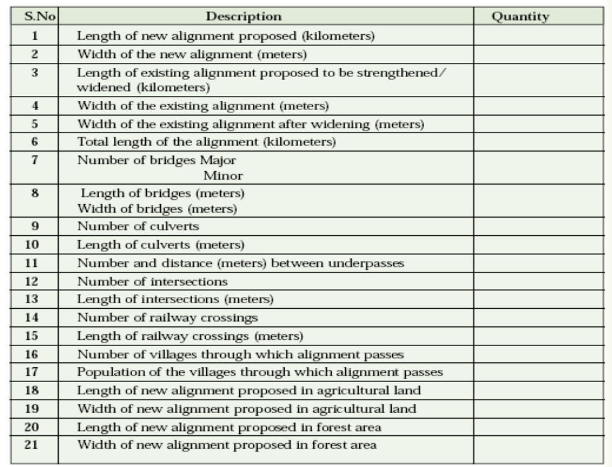

Slide 27
FINAL LOCATION SURVEY
Purpose
to fix the centre line of the selected alignment and collect additional data for the design and preparation of working drawings. If extensive data is collected earlier the survey work here might be limited.

Slide 28
TASKS DURING FINAL LOCATION SURVEY
Pegging the centre line: usually done at stations established at 30m/20m intervals with reference to preliminary traverse/ base line (if used earlier) or a control survey (if aerial survey was used).
Centre-line Levelling: at the stations and at intermediate points between stations where there is a significant change in the slope to obtain the representative profile of the ground

Slide 29
TASKS (CONT.)
Cross-section Levelling: at each station and at points with significant change in ground slope
Intersecting Roads: the directions of the centre line of all intersecting roads, profiles, and cross-sections for some distance on both sides
Ditches and Streams: horizontal alignment, profile, and cross section levelling of the banks of the stream/river

Slide 30
DRAWINGS & REPORTS
The data, after the necessary investigation and final location survey, is sent to the design office to be used for
  geometric design, pavement design, and design of drainage and other structures, preparation of drawings, reports, and specifications
A complete sets of drawings for a road design include:
  Site plan of proposed alignment
  Detailed Plan & Profile
  Cross-sections for Earth work
  Typical Roadway sections at selected locations (e.g. junctions)
  A mass-haul diagram
  Construction details of structures like bridges, culverts, ….

Slide 31
IN SUMMARY
Steps for determining potential horizontal alignment
Step 1: Examine contours along the shortest path and estimate the steepest ground slope along the route
Let in the example;
Line A-B represents the shortest path
Let the slope of x-y be more than permissible value , then the shortest path will not justify
A
x
y
B

Slide 32
A
Step 2:
Draw a new trial alignment that reduces the ground slope
Step 3:
Convert the sketch in to dimensioned Tangent and circular curve
x
y
B

Slide 33

NGL
Step 4:
Construct the profile of NGL and the proposed road level.
Check:
    The maximum slope
    The maximum depth of cut and fill
    The balance of cut and fill
    Grades near intersections
    E.t.c
q
RFL
Station

Slide 34
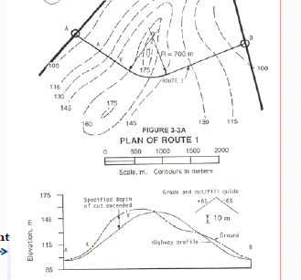
Example: Alignment 1

Slide 35
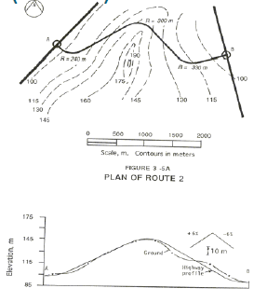
Alignment 2

Slide 36
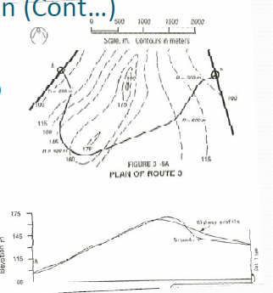
Alignment 3

Slide 37
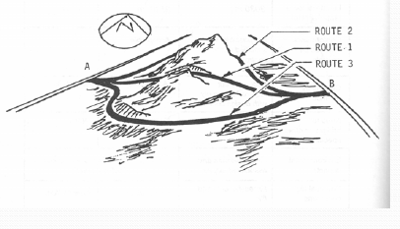

Slide 38
EVALUATION SUMMARY TABLE [EXAMPLE]
Criteria | Evaluation Results
 | Alternative I | Alternative II | Alternative III
Length
Design Control
Cut & fill Balance
Need for special structure
Environmental Impact
Potential High cost Item

Slide 39
END of (Chapter -1)

